Slide 1

Introductions,
Course Info & Tools
W200 Introduction to Data Science Programming
Week 01
version: Dec 31, 2019

Slide 2

Agenda
Welcome introductions
Course Overview
Mechanics
GitHub & git
Shell Scripts

Slide 3

Brief Introductions
Quick intro: your name, where you live and work
What do you do with computing?
For what do you want to use data science skills?
Introducing the Breakout Rooms. We have team-based projects in this course, so let’s spend a few minutes chatting in smaller groups.

Slide 4
1. Course Overview
Pretty fast-moving course and students join the course with a range of computing skills, programming experiences from neophyte to pro.
Our goal is to establish a strong base for all students. Sharing your knowledge with other students helps all.
Feel free to ask questions of each others, the instructors, and especially of the TAs.
There’s a couple of ways of communicating with W200-group, Slack, Office Hours, and TA appointments.

Slide 5
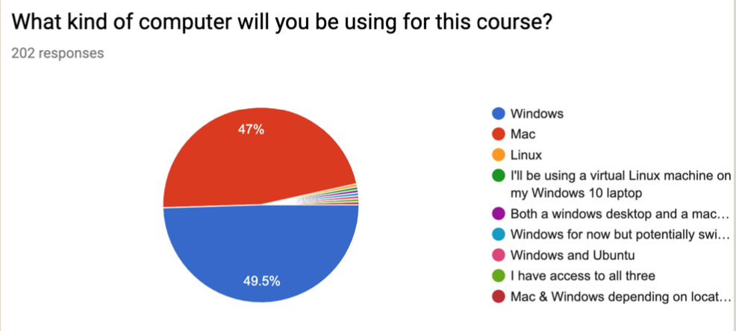
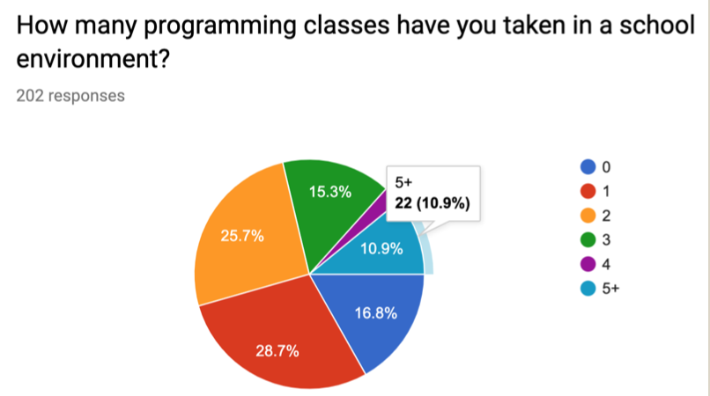
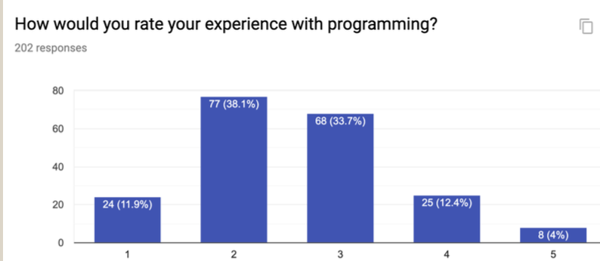
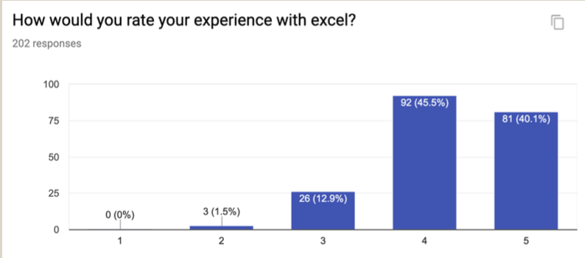
1. Overview: student computing
Students with less coding experience tend to enjoy significant experience in other areas.

Slide 6
1. Overview: Breakout Rooms
There’s a lot of individual effort in learning to code for DataSci; and there’s breakout rooms to give everyone a chance to participate.
During these breakouts we work on a weekly Activity notebook - encourage and mentor each other.
This is true to life as a data scientist … at times you’ll gossip code and jointly share techniques.

Slide 7
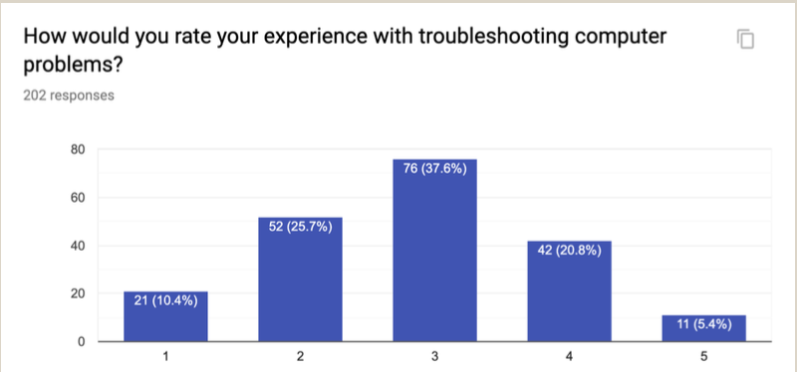
1. Overview: Getting help
Much of the time you’ll have to discover answers on your own (that’s how it is in computing).
Learning to interpret and respond to errors are important skills. You’ll be expected to deal with files in a domain that we haven’t covered. Focus on the data!

Slide 8
2. Course Curriculum (1 of 2)
Week 1: Getting to know the development environment
Weeks 2-6: Python Fundamentals
Starting out, sequence types & dictionaries; control and algorithms; functions, complexity
Weeks 7-8: Object-Oriented Design & Programming
Classes, OOD, OOP
Individual OOP program

Slide 9
2. Course Curriculum (2 of 2)
Weeks 9-14: Data Analysis
Text & Binary Data
Numpy (vectors)
Pandas (Data Frames)
Matplotlib, Seaborne (Visualization)
Advanced Pandas (Aggregation & Group Operations_
Testing
Team Data Analysis Project & Presentation

Slide 10
3. Grading
30% - Homework (that you submit to your GitHub)
40% - Projects (20% for the individual OOP; 20% for the team data analysis project)
20% - Online Exams (Midterm 10%, 24-hour window; Final is 10%, 48-hour window) [Don’t wait ’til the last moment to start!]
10% - Participation

Slide 11
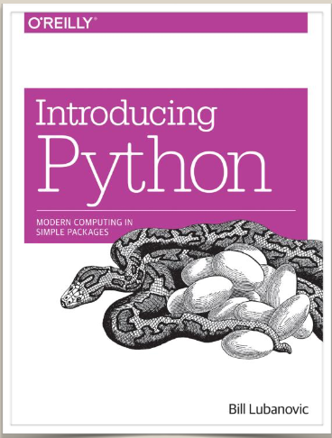
4. Materials: Asynch and Synch
ISVC: view/study the asynchronous materials before the live session. Then attend one of the weekly live meetings.
study.net: read/study before our live session
GitHub: homework assignments are posted after the live session. Students pull down from this site. Push your completed homework to your individual SUBMISSIONS folder.
Other python and data sci texts are in the Resources folder.

Slide 12
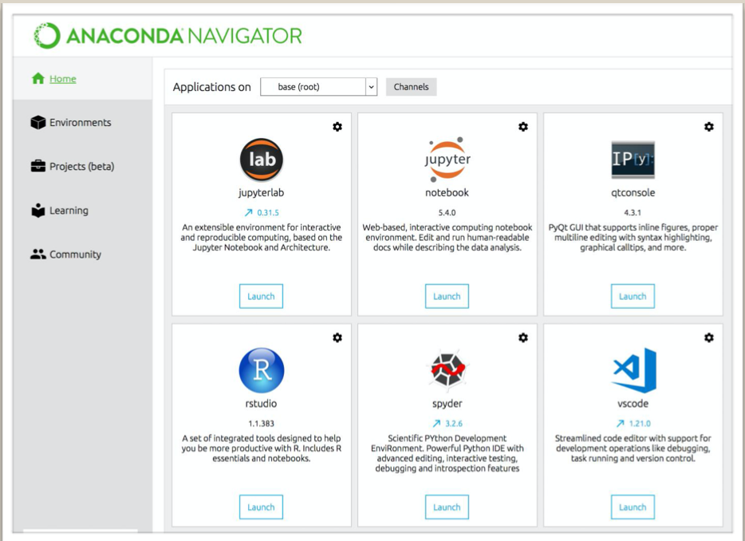
4. Programs & Tools
Anaconda
Jupyter
Python (version 3)
Bash shell*
Git
Text Editor (Atom, NotePad+, BBEdit)
Windows 10 has PowerWindow; earlier editions may need GitBash

Slide 13
4. Resources
Syllabus: https://docs.google.com/document/d/1MKp- RddgD9ZvaOK1w4LCIdGYivhwldtlV5NU_bGLvts
Live Calendar: https://docs.google.com/spreadsheets/d/1jNmL4-K6F7OfTTAtscraFrQHdo-8- KepdhUbEaFGXSY
Homework Assignments:
• https://github.prod.oc.2u.com/UCB-INFO-PYTHON/assignments_upstream_spring20
Communication to instructors & other students: w200-python-2020-spring@googlegroups.com
Communication with instructors only: mids-python-instructors@googlegroups.com
Slack Channels for information communication: ucbischool.slack.com channel #w200-python

Slide 14
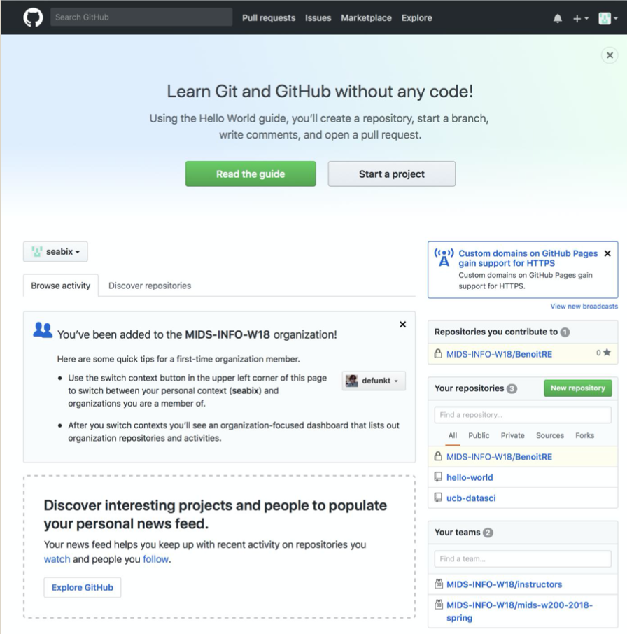
4. Github
File sharing & Version Control Site:
https://github.prod.oc.2u.com
Please “Read the Guide”
Press “Discover…” search for UCB-INFO-PYTHON/Installation
Read “Completing your First Exercise with Git Reading Card”; follow the instructions.

Slide 15
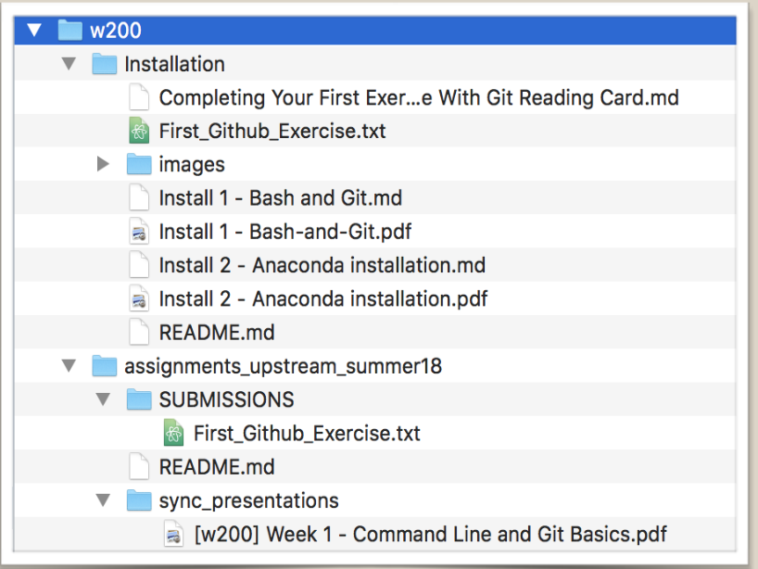
4. More about Git
Folder structure:
/Users/tom/w200
/Users/tom/w200/FirstnameLastnameREPO/
/Users/tom/w200/FirstnameLastnameREPO/SUBMISSIONS/
Let’s visit GitHub for a demonstration

Slide 16
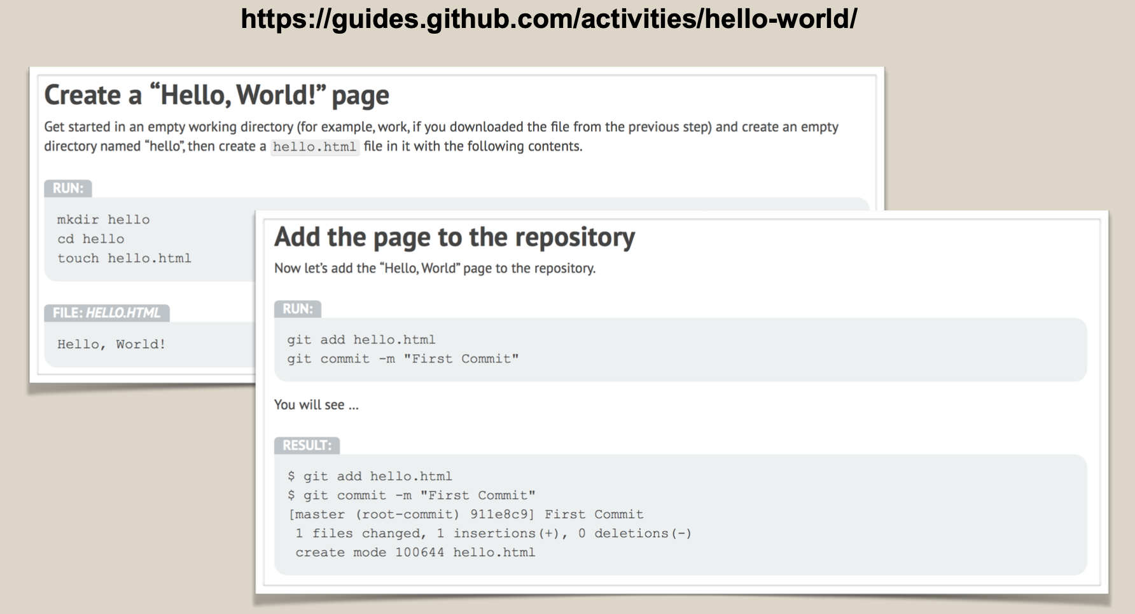
your repository
TomJonesREPO
get assignments here
assignments_upstream_spring20
fun stuff
github-playground

Slide 17


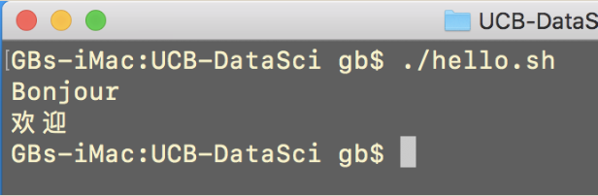


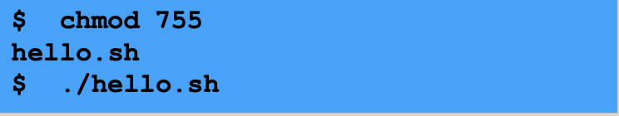
5. Shell Scripts
Create a shell script using a text editor
Set the file permissions (rwx,rx,rx; 0755)
Run the script.
Optional: see these resources (10 Concepts; Ox-OS.pdf) about Unix and Operating Systems

Slide 18
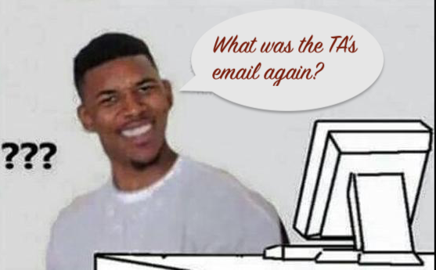
6. Wrap-up
Enjoy the course - it’s a challenge but keep at it!
If you’re working along for > 1 hour, take a break and have a “sanity check.” [Really.] Shoot an email to colleagues, TAs, instructors (the w200 group is a good place).
Welcome and enjoy Introduction to Data Science Programming
Gunnar, Chris, Rob, Chris W., Mark, & Gerry

